Slide 1
The liturgy for this week was taken from McRae-McMahon, D Liturgies for high days. SPCK: Unley, 2007 and therefore cannot be posted online.
Instead, I am offering this PowerPoint of desert photos that were used in the service for your reflection. The first set of photos were taken on the West Nullarbor Patrol, visited by the Outback Chaplains of the Uniting Church’s Frontier Services. The patrol starts at Esperance in the South, up to the Trans-Australian line and then east to the border with South Australia. It is an area larger than many European countries.
The second set of photos are from the Midbar – the wilderness or desert in the South of Israel, mostly taken in the area on the west coast of the Dead Sea.

Slide 2
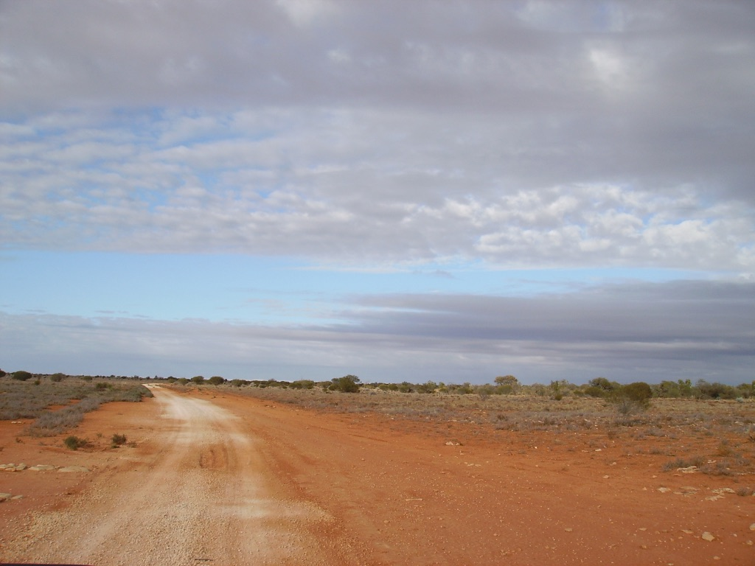

Slide 3
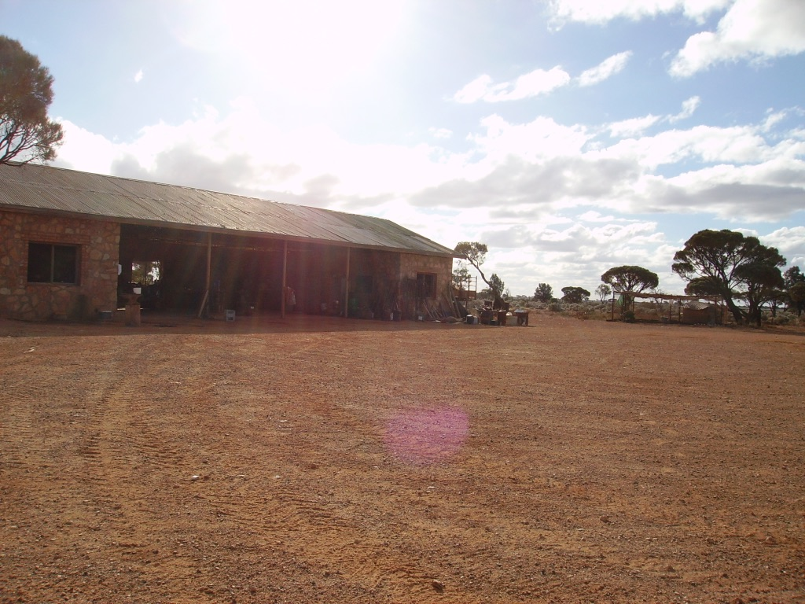

Slide 4
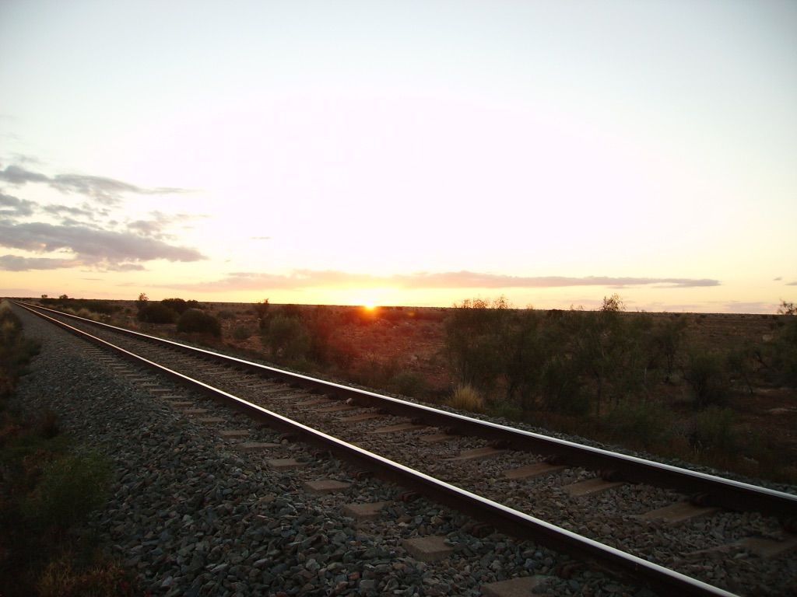

Slide 5
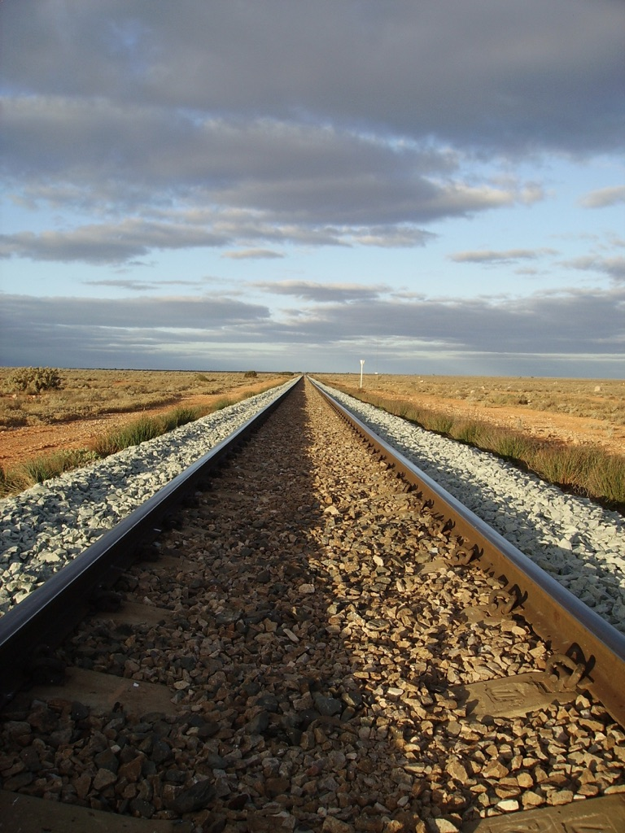

Slide 6
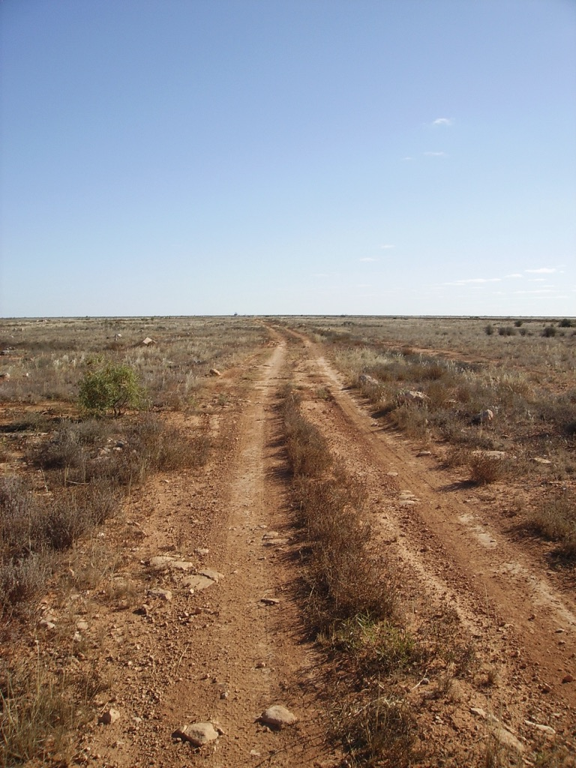

Slide 7
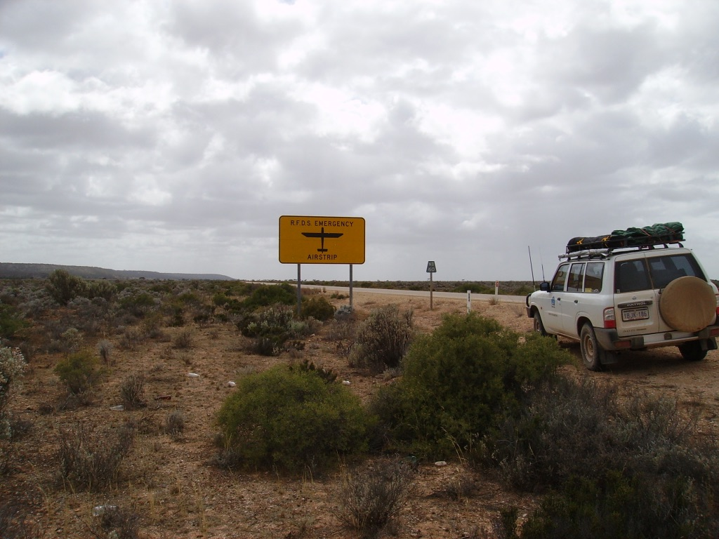

Slide 10
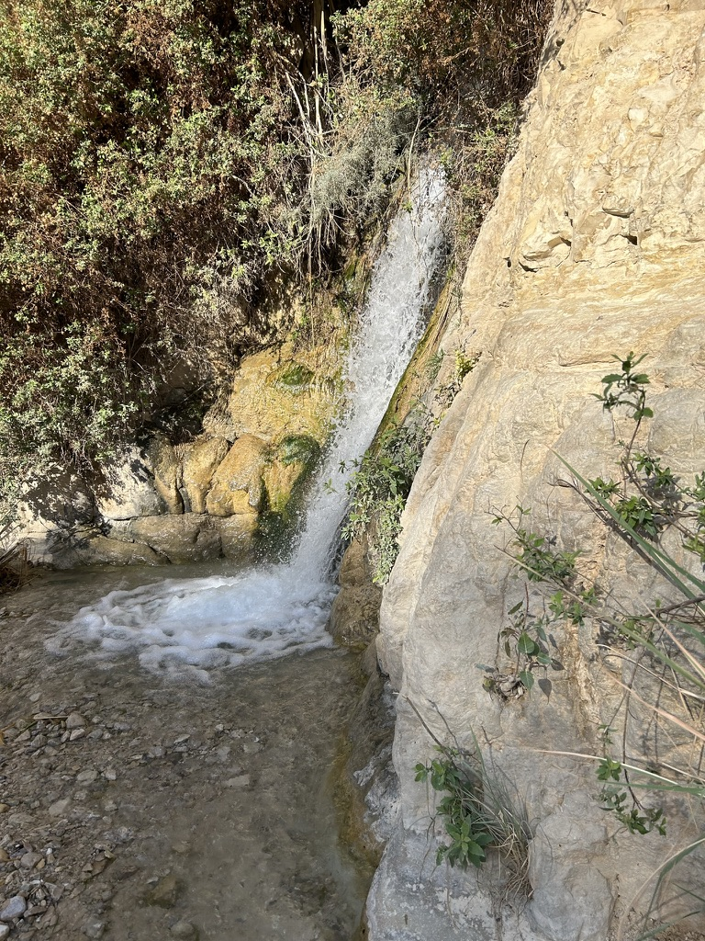

Slide 11
